Slide 1
DIABETES PREDICTION USING MACHINE LEARNING
BY
THATI RISHI REDDY

Slide 2
CONTENTS:
Abstract
Key words
Proposed system
Algorithm
Module Description
Experimental Setup
Result
Conclusion

Slide 3
ABSTRACT:
Diabetes is an illness caused because of high glucose level in a human body. Diabetes should not be ignored if it is untreated then Diabetes may cause some major issues in a person like: heart related problems, kidney problem, blood pressure, eye damage and it can also affects other organs of human body. Diabetes can be controlled if it is predicted earlier. To achieve this goal this project work we will do early prediction of Diabetes in a human body or a patient for a higher accuracy through applying, Various Machine Learning Techniques. Machine learning techniques Provide better result for prediction by con- structing models from datasets collected from patients. In this work we will use Machine Learning Classification and ensemble techniques on a dataset to predict diabetes. Which are Logistic Regression (LR),Support Vector Machine (SVM), K-Nearest Neighbor (KNN), Random Forest (RF), Navies Bayes(NB), and Gradient Boosting (GB) .The accuracy is different for every model when compared to other models. The Project work gives the accurate or higher accuracy model shows that the model is capable of predicting diabetes effectively. Our Result shows that Random Forest achieved higher accuracy compared to other machine learning techniques.

Slide 4
KEY WORDS:
Diabetes
Machine Learning
Logistic Regression
Random Forest
Navies Bayes
Dataset

Slide 5
PROPOSED SYSTEM:
Dataset Description: Collecting a data set which contains details of Diabetic and Non-Diabetic patients. Data set contains attributes such as
Pregnancies
Glucose
Blood Pressure
Skin Thickness
Insulin
BMI
Diabetes Pedigree Function
Age
The 9th attribute is class variable of each data points. This class variable shows the outcome 0 and 1 for diabetics which indicates positive or negative for diabetics.

Slide 6
Data Preprocessing: Data preprocessing is most important process. Mostly healthcare related data contains missing value and other impurities that can cause effectiveness of data. To improve quality and effectiveness obtained after mining process, Data preprocessing is done. To use Machine Learning Techniques on the dataset effectively this process is essential for accurate result and successful prediction. From Diabetes dataset we need to perform pre processing in two steps.
Missing Values removal: Remove all the instances that have zero (0) as worth. Having zero as worth is not possible. Therefore this instance is eliminated. Through eliminating irrelevant features/instances we make feature subset and this process is called features subset selection, which reduces dimensionality of data and help to work faster..
Splitting of data: After cleaning the data, data is normalized in training and testing the model. When data is spitted then we train algorithm on the training data set and keep test data set aside. This training process will produce the training model based on logic and algorithms and values of the feature in training data. Basically aim of normalization is to bring all the attributes under same scale.
Apply Machine Learning: When data has been ready we apply Machine Learning Technique. We use different classification and ensemble techniques, to predict diabetes. The methods applied on Pima Indians diabetes dataset. Main objective to apply Machine Learning Techniques to analyze the performance of these methods and find accuracy of them, and also been able to figure out the responsible/important feature which play a major role in prediction.

Slide 7
ALGORITHM:
LOGISTIC REGRESSION(LR):
Logistic regression is also a supervised learning classification algorithm. It is used to estimate the probability of a binary response based on one or more predictors. It classify the data in binary form means only in 0 and 1 which refer case to classify patient that is positive or negative for diabetes.
Main aim of logistic regression is to best fit which is responsible for describing the relationship between target and predictor variable. Logistic regression is a based on Linear regression model. Logistic regression model uses sigmoid function to predict probability of positive and negative class.
SUPPORT VECTOR MACHINE(SVM):
Support Vector Machine also known as svm is a supervised machine learning algorithm. Svm is most popular classification technique. Svm creates a hyperplane that separate two classes. It can create a hyperplane or set of hyperplane in high dimensional space. This hyper plane can be used for classification or regression.
Svm differentiates instances in specific classes and can also classify the entities which are not supported by data. Separation is done by through hyperplane performs the separation to the closest training point of any class.

Slide 8
K NEAREST NEIGHBOUR(KNN):
KNN is also a supervised machine learning algorithm. KNN helps to solve both the classification and regression problems. KNN is lazy prediction technique. KNN assumes that similar things are near to each other. Many times data points which are similar are very near to each other.
KNN helps to group new work based on similarity measure. KNN algorithm record all the records and classify them according to their similarity measure. For finding the distance between the points uses tree like structure.
To make a prediction for a new data point, the algorithm finds the closest data points in the training data set its nearest neighbors.
RANDOM FOREST(RN):
Random Forest It is type of ensemble learning method and also used for classification and regression tasks. The accuracy it gives is grater then compared to other models. This method can easily handle large datasets. Random Forest is developed by Leo Bremen. It is popular ensemble Learning Method.
Random Forest Improve Performance of Decision Tree by reducing variance. It operates by constructing a multitude of decision trees at training time and outputs the class that is the mode of the classes or classification or mean prediction (regression) of the individual trees.

Slide 9
NAVIES BAYES(NB):
Naive Bayes algorithm is a supervised learning algorithm, which is based on Bayes theorem and used for solving classification problems. It is mainly used in text classification that includes a high-dimensional training dataset.
Naive Bayes Classifier is one of the simple and most effective Classification algorithms which helps in building the fast machine learning models that can make quick predictions.
It is a probabilistic classifier, which means it predicts on the basis of the probability of an object.
GRADIENT BOOSTING(GB):
Gradient Boosting is most powerful ensemble technique used for prediction and it is a classification technique. It combine week learner together to make strong learner models for prediction.
It uses Decision Tree model. it classify complex data sets and it is very effective and popular method. In gradient boosting model performance improve over iterations.

Slide 10
MODULE DESCRIPTION:
Pandas: Pandas is a fast, powerful, flexible and easy to use open source data analysis and manipulation tool, built on top of the python programming language.
NumPy: NumPy is a Python library used for working with arrays. It also has functions for working in domain of linear algebra, Fourier transform, and matrices.
Seaborn: Seaborn is an open-source Python library built on top of matplotlib. It is used for data visualization and exploratory data analysis. Seaborn works easily with data frames and the Pandas library.
Pickle: Pickle in Python is primarily used in serializing and deserializing a Python object structure. It the process of converting a Python object into a byte stream to store it in a file/database, maintain program state across sessions, or transport data over the network.
Sklearn: Scikit-learn is probably the most useful library for machine learning in Python. The Sklearn library contains a lot of efficient tools for machine learning and statistical modeling including classification, regression, clustering and dimensionality reduction.

Slide 11
EXPERIMENTAL SETUP:
A Data set can be divided into Testing and Training sets.
The training set is what the model is trained on.
The test set is used to see how well that model performs on unseen data.
By using Supervised Machine Learning techniques model can be train and test the data.
Write a code for displaying the evaluation result considering accuracy metrics.
Compare the obtained results for trained models and specify which is better.
So, it can be useful for predicting a person is Diabetic or Non-Diabetic.

Slide 12
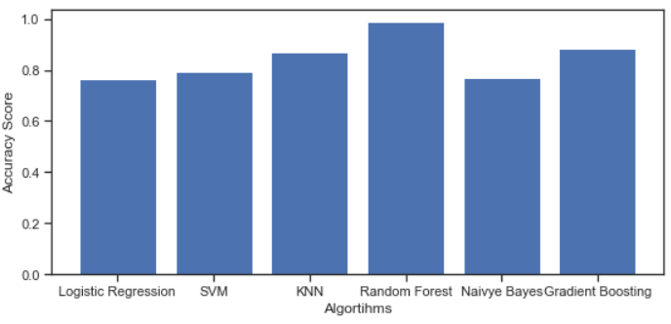
RESULTS:
By using Supervised Machine algorithms like Logistic Regression, Support Vector Machine, KNN, Random Forest, Navies Bayes and Gradient Boosting. Random Forest gives High accuracy than the other algorithms.
It gives 98% Accuracy and ROC 97%.

Slide 13
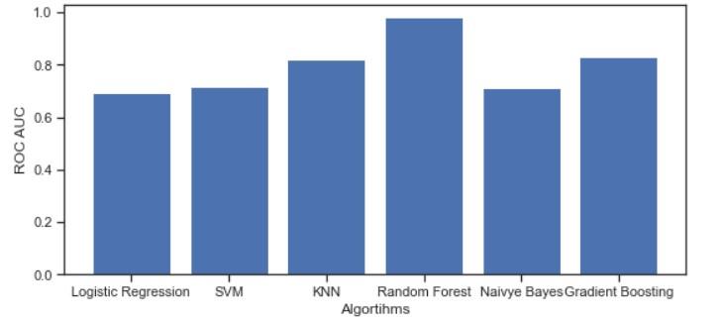
It also shows that Detection accuracy increases when more dataset is used as training dataset.

Slide 14
CONCLUSION:
The main aim of this project was to design and implement Diabetes Prediction Using Machine Learning Methods and Performance Analysis of that methods and it has been achieved successfully. The proposed approach uses various classification and ensemble learning method in which Logistic Regression, Support Vector Machine, KNN, Random Forest, Navies Bayes and Gradient Boosting are used. And 98% classification accuracy has been achieved. The Experimental results can be asst health care to take early prediction and make early decision to cure diabetes and save humans life.

Slide 15
THANK YOU

